Slide 1

Stress and Alcohol
CC24_8: Junseo, Gavin, Azel, Kaixin, Albert, Fengjun

Slide 2
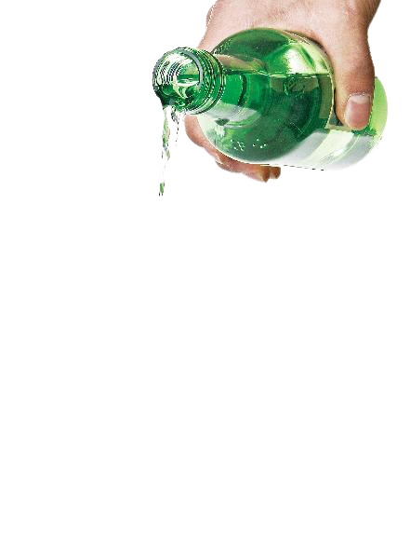


ConTEnts
Initial Approach
Key limitations, Data Cleaning and Assumptions
Main insight with evidence
Summary

Slide 3




Initial approach
As most of our group members have international background, we could share some difficulties living in Australia followed by the stress and the its management. Some of us suggested that drinking alcohol with friends is effective to get rid of stress; Hence, we could produce two main questions:
Is the stress level of international students higher than domestic?
More the stress, More we drink?

Slide 4






Limitation
Survey Limitation: The survey was conducted only among DATA1X01 students, which means our data may not reflect the entire population of USYD students.
2. Response quality: Because this is a non-scored questionnaire, some students may have filled it out casually to complete it quickly, which could introduce inaccuracy into the data
Assumption
Data honesty: We assume that students answered the survey honestly and reasonably, excluding some extremes
Sample representation: We assume that our sample of DATA1X01 students is representative of the USYD student population in terms of stress levels and drinking patterns

Slide 5
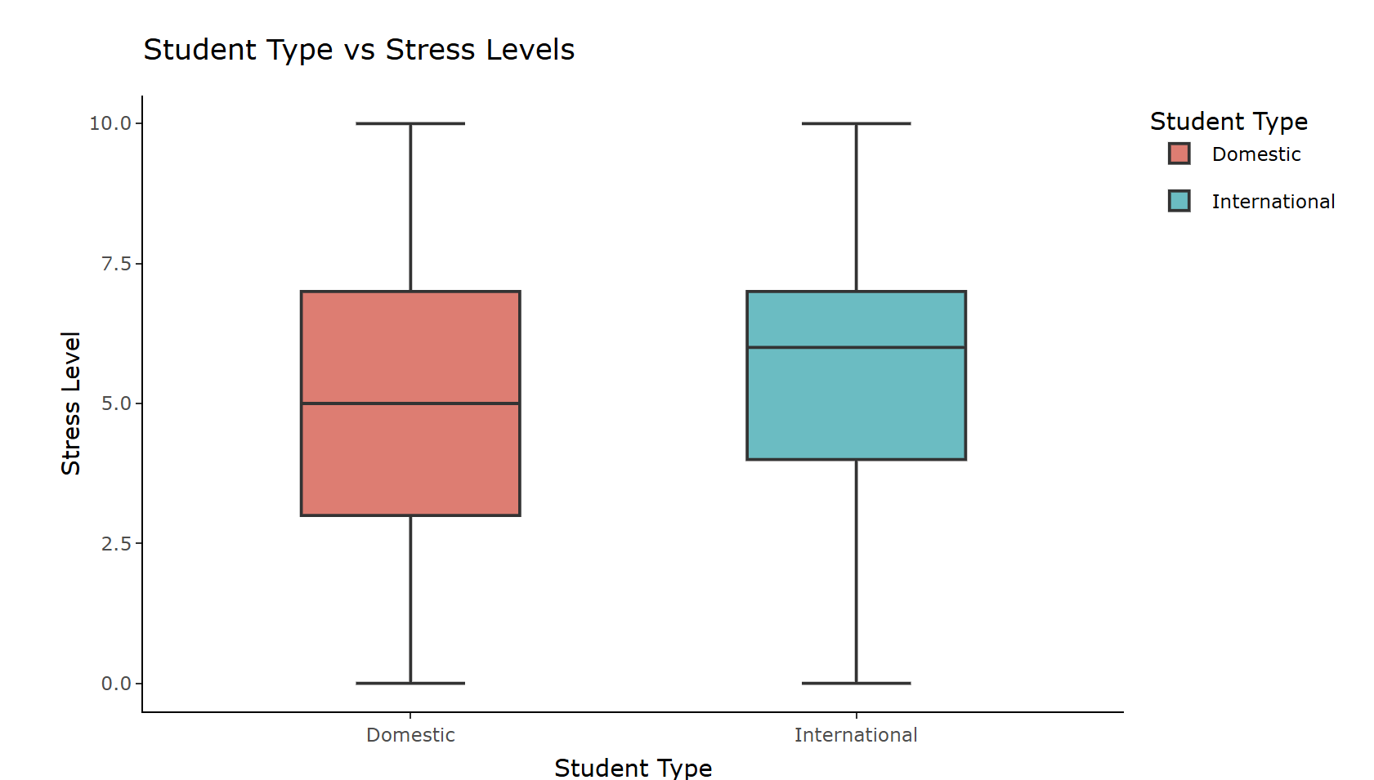

Main insight with evidence
 | Domestic | International
Q1 | 3.00 | 4.00
Median | 5.00 | 6.00
IQR | 4.00 | 3.00

Slide 6
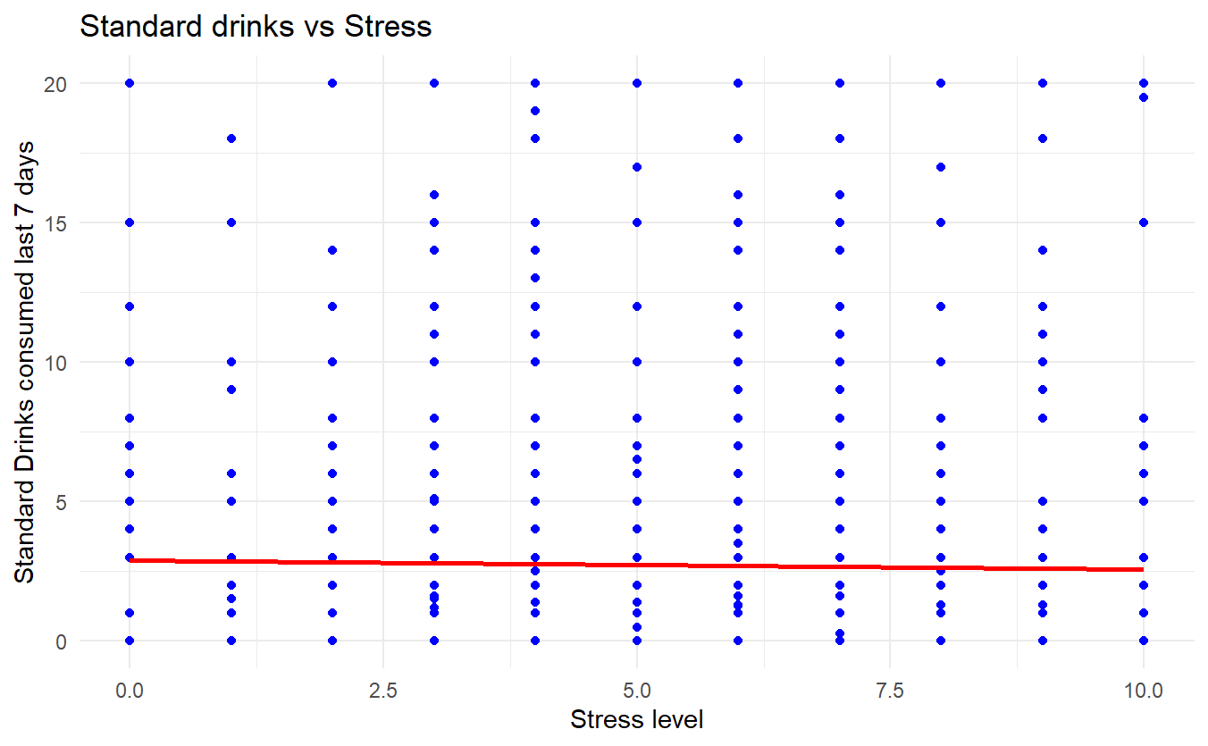
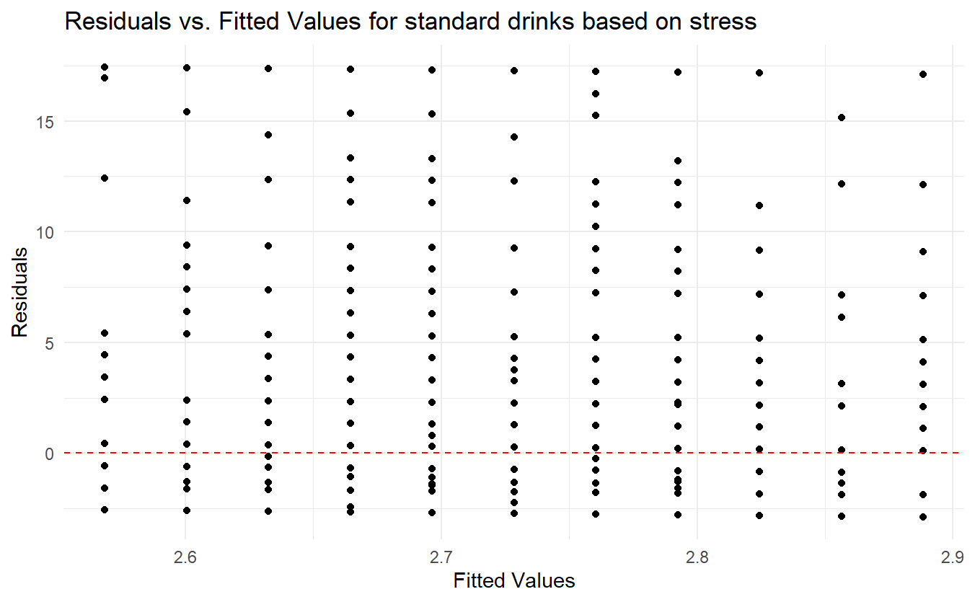


Main insight with evidence

Slide 7
Summary
Overall, international students show higher stress levels than domestic students.
However, the relationship between alcohol consumption and students’ stress levels is inconsistent.
Implementing targeted stress reduction programs for both international and domestic students could help manage their stress and potentially reduce alcohol consumption, thereby improving their academic performance.

Slide 8
Thank you

